Slide 1
Visualization
Dhruv Joshi

Slide 2
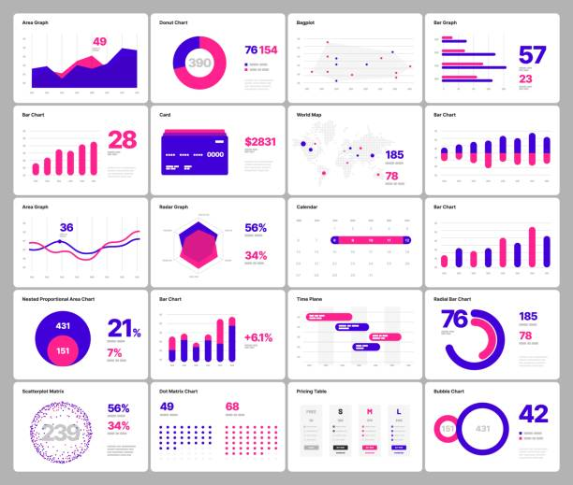
AGENDA
Introduction
Matplotlib
Seaborn
Plotly
SUMMARY

Slide 3
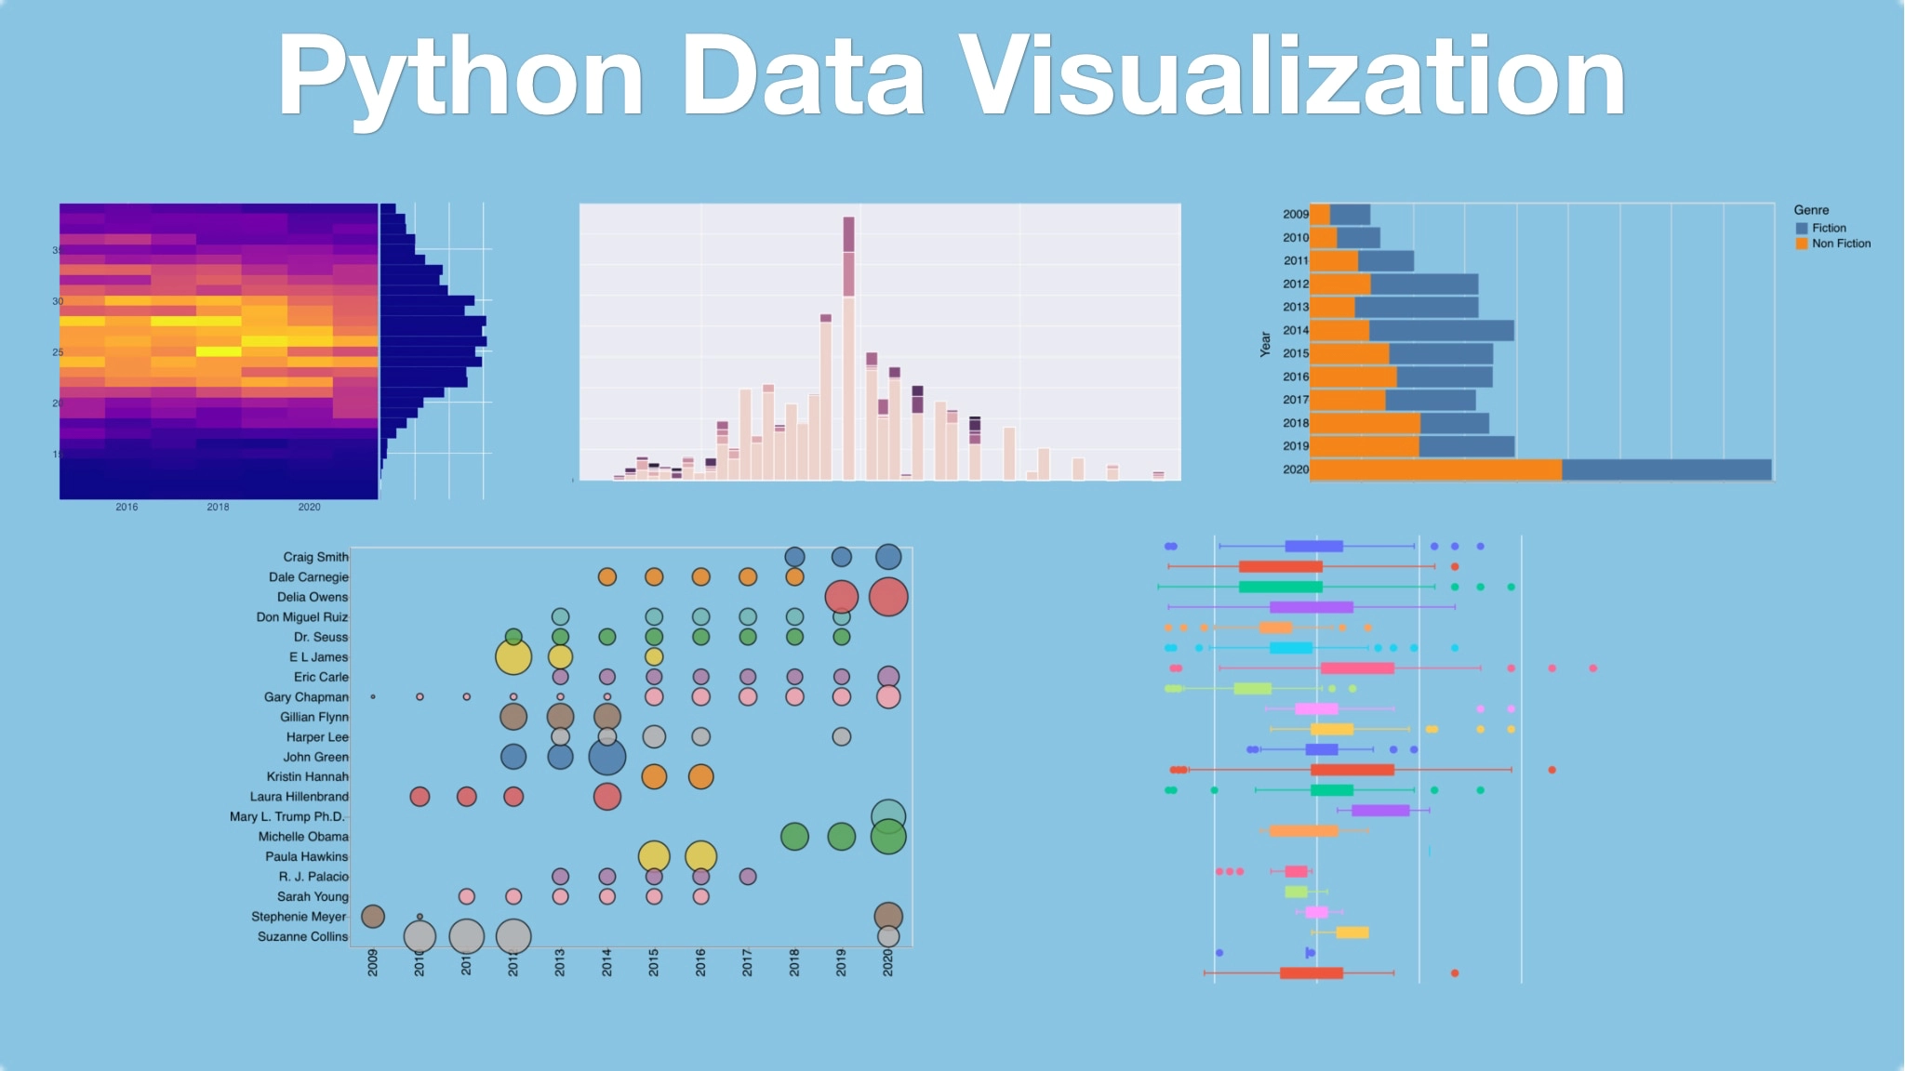
INTRO
The process of finding trends and correlations in our data by representing it pictorially is called Data Visualization. To perform data visualization in python, we can use various python data visualization modules such as Matplotlib, Seaborn, Plotly, etc. Let’s compare and check the result of Matplotlib, Seaborn and Plotly as this 3 are widely used libraries.

Slide 4
Matplotlib
Pair plot – Scatter plot - histogram

Slide 5
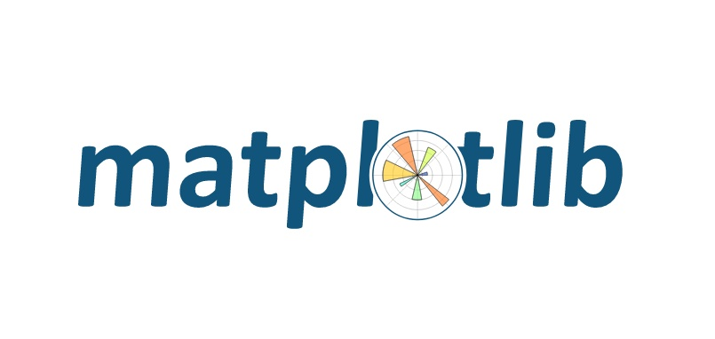
Matplotlib is a popular plotting library in Python used for creating high-quality visualizations and graphs. It offers various tools to generate diverse plots, facilitating data analysis, exploration, and presentation

Slide 6
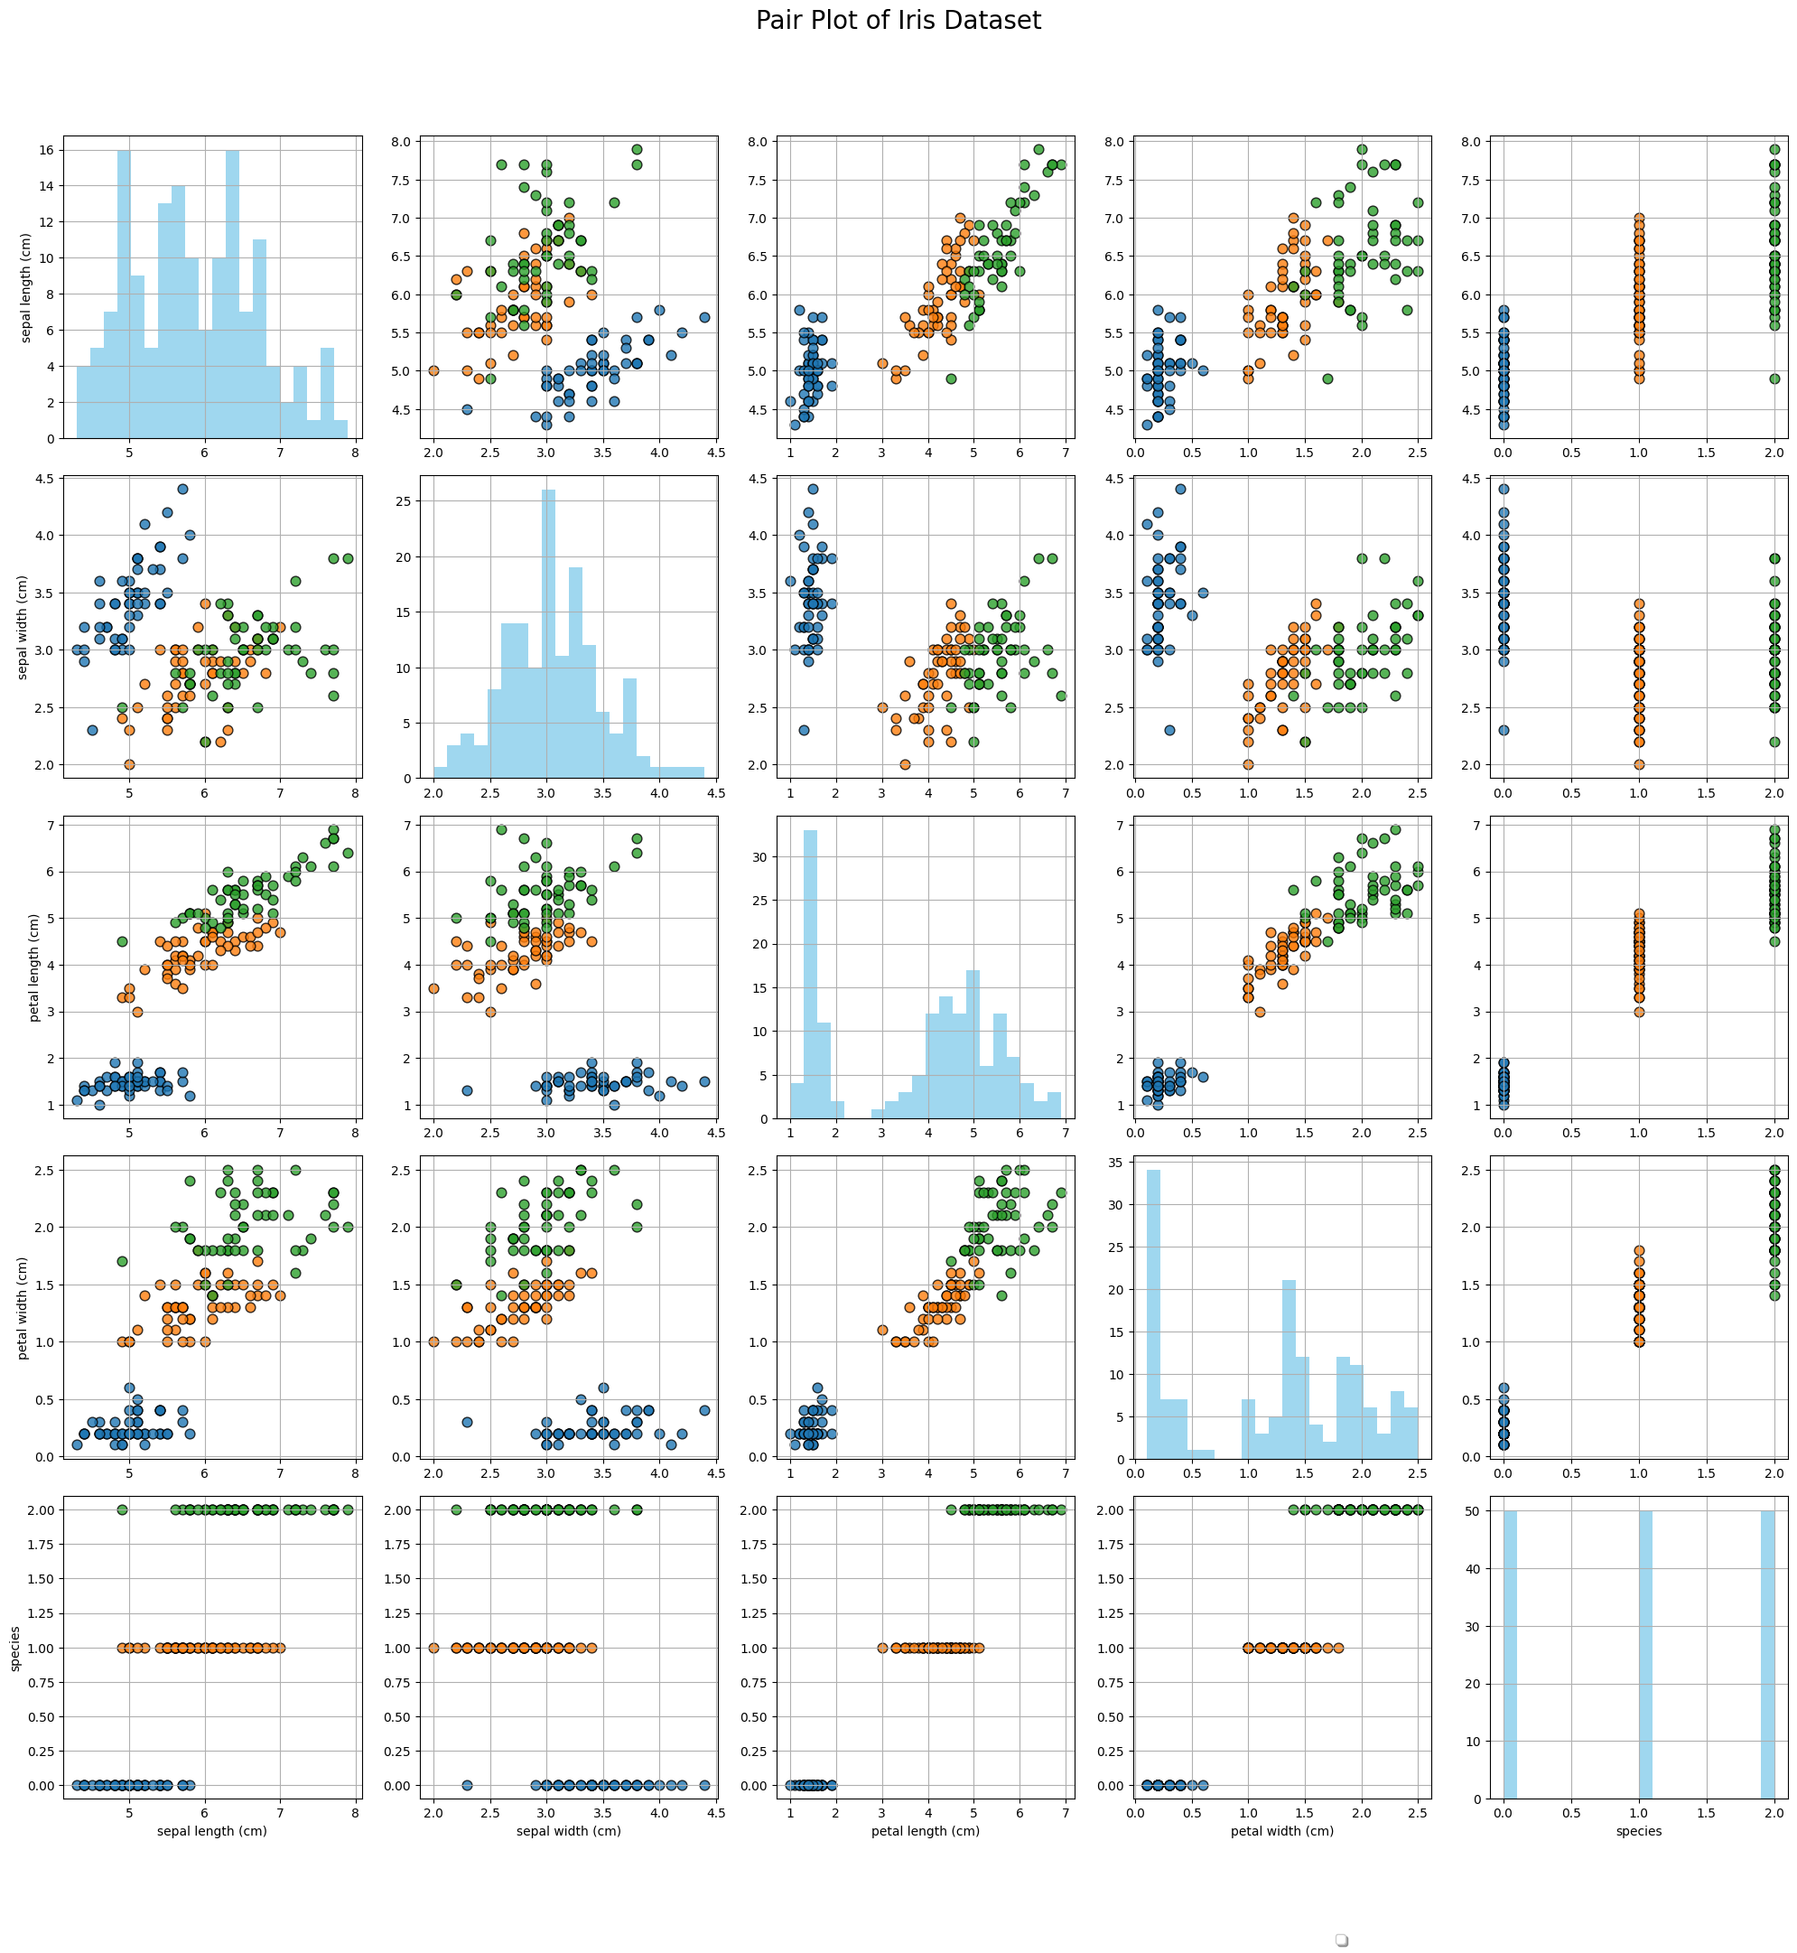
Pair plot

Slide 7
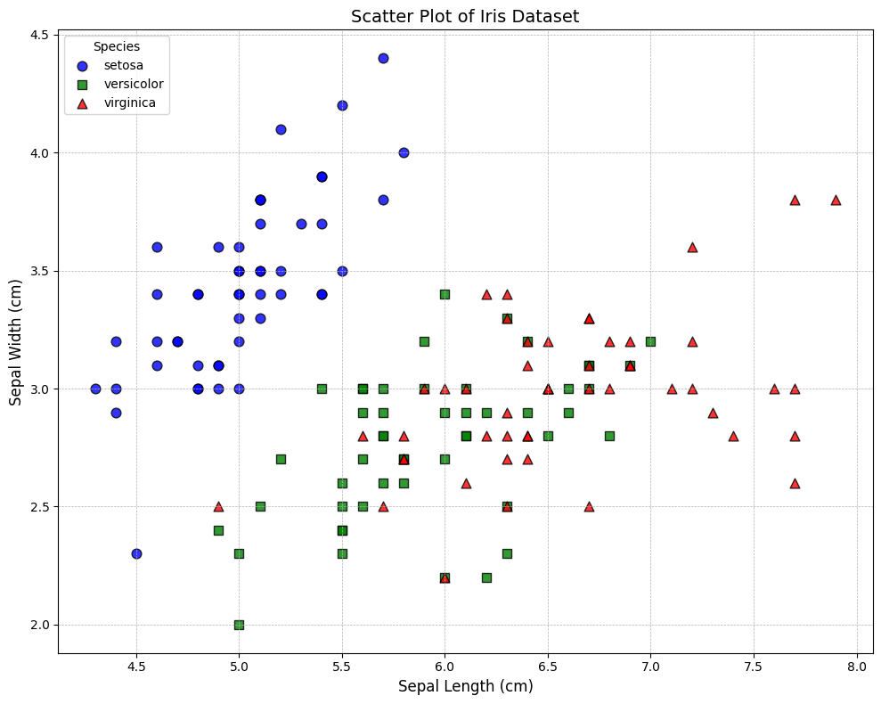
scatter plot

Slide 8
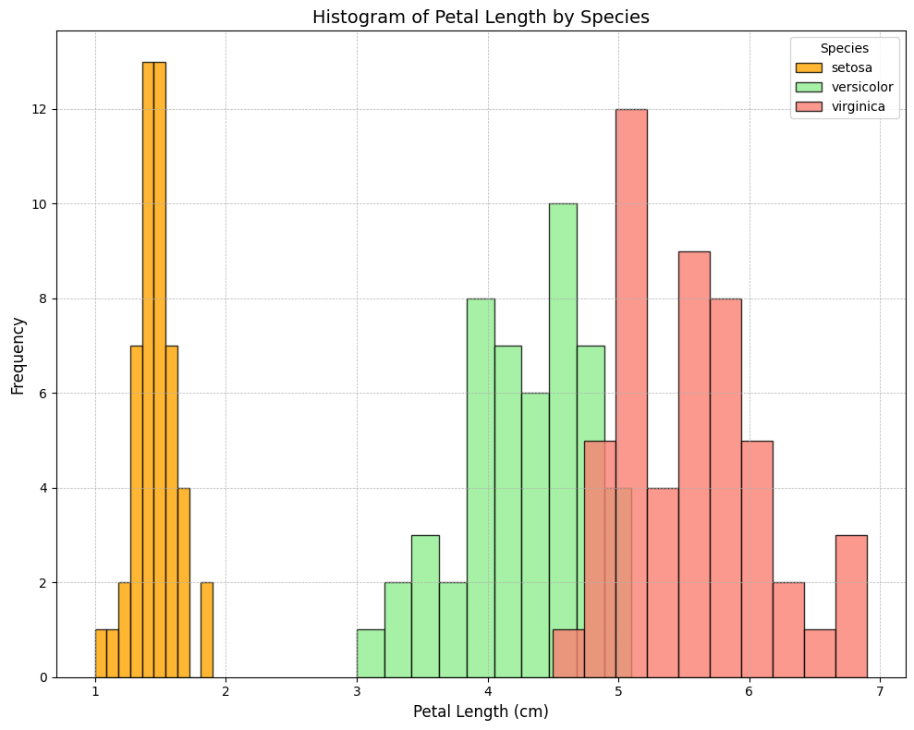
histogram

Slide 9
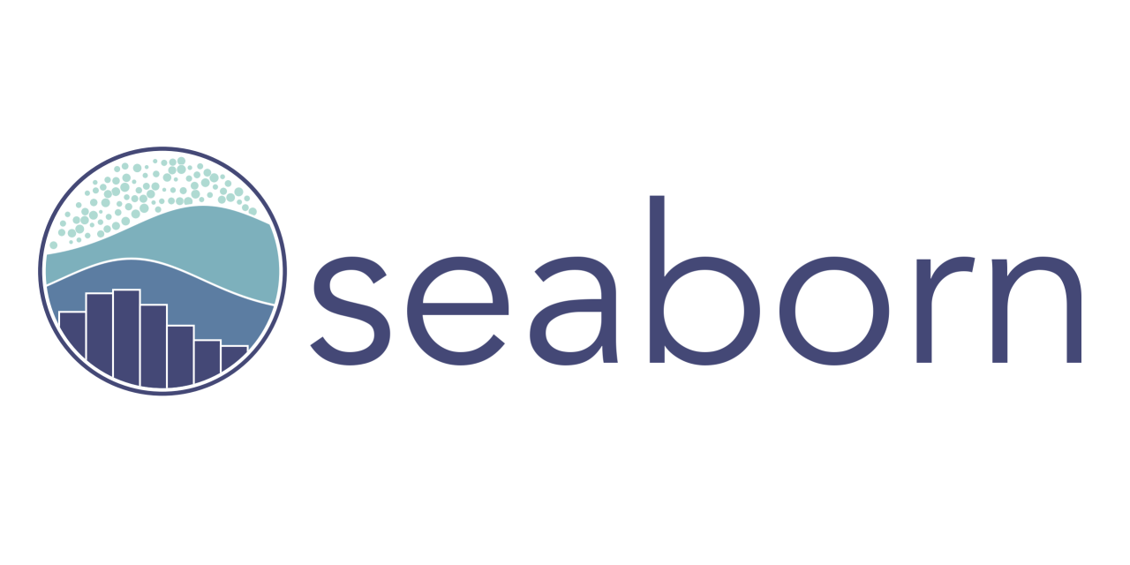
Seaborn is a library for making statistical graphics in Python. It builds on top of matplotlib and integrates closely with pandas data structures. Seaborn helps you explore and understand your data.

Slide 10
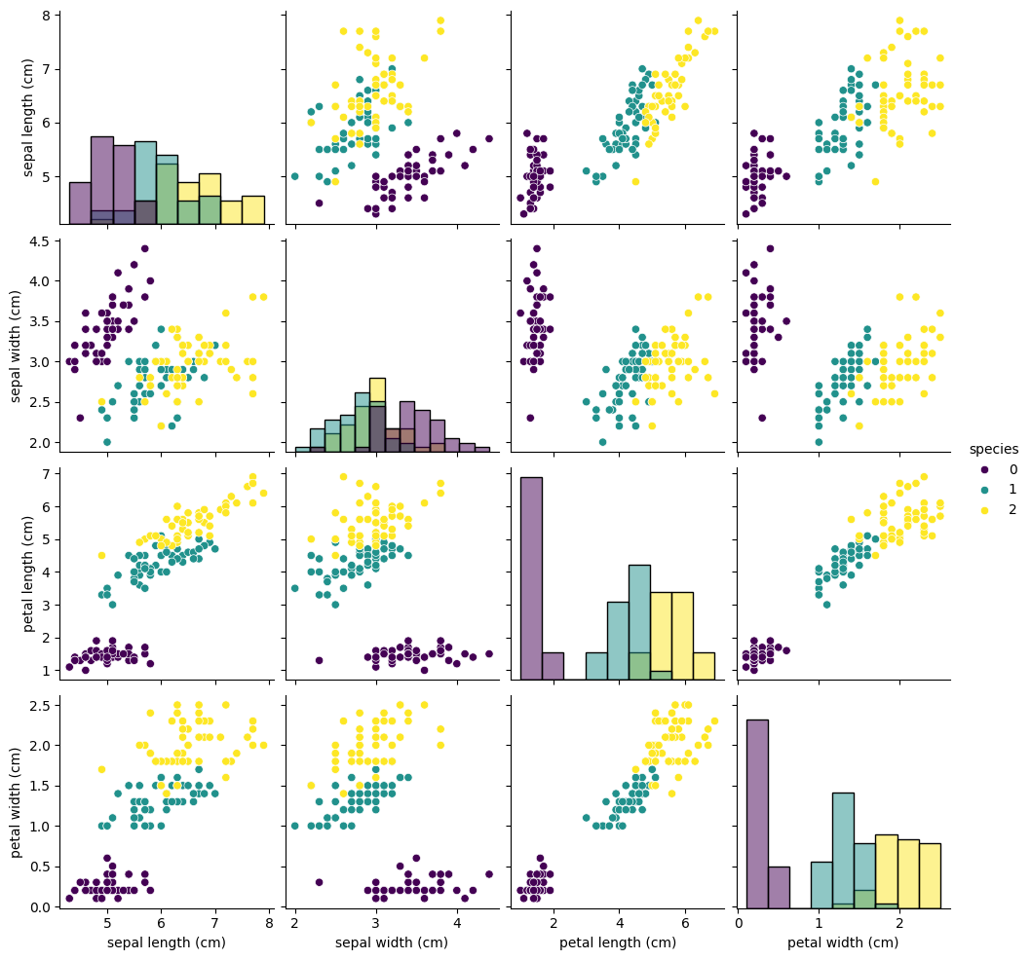
Pair plot

Slide 11
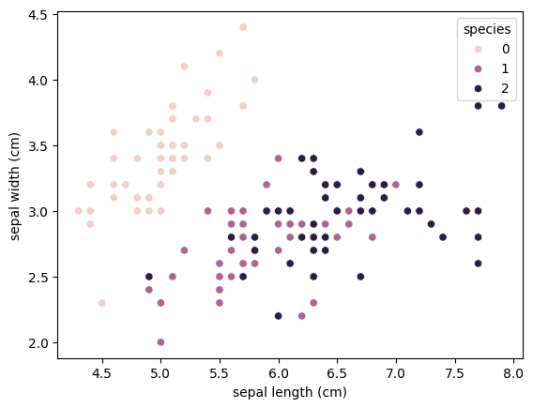
Scatter plot

Slide 12
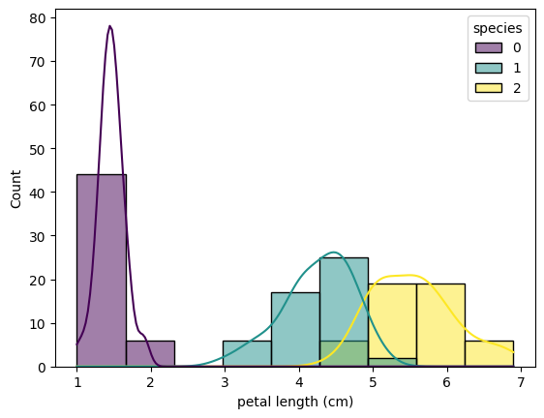
histogram

Slide 13
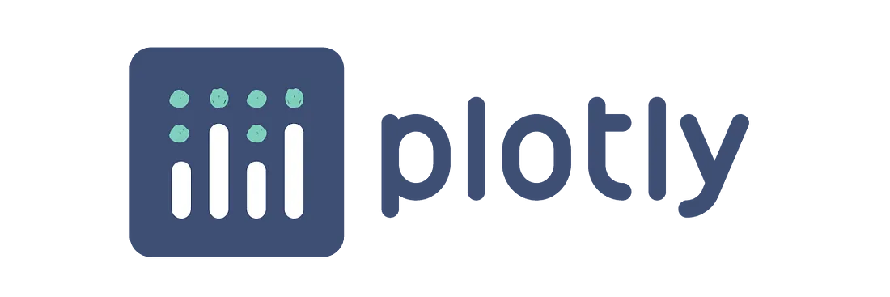
Plotly is an open-source module of Python that is used for data visualization and supports various graphs like line charts, scatter plots, bar charts, histograms, area plots, etc. Plotly produces interactive graphs, can be embedded on websites, and provides a wide variety of complex plotting options

Slide 14
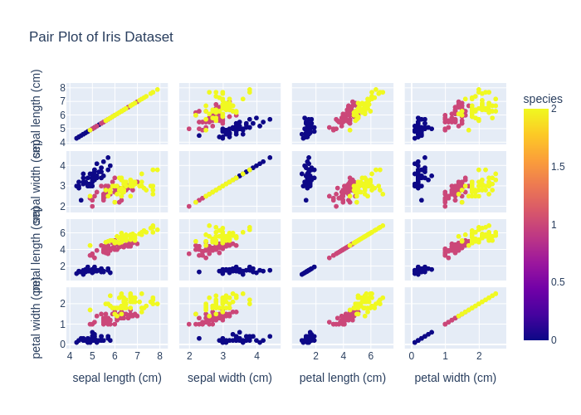
Pair plot

Slide 15
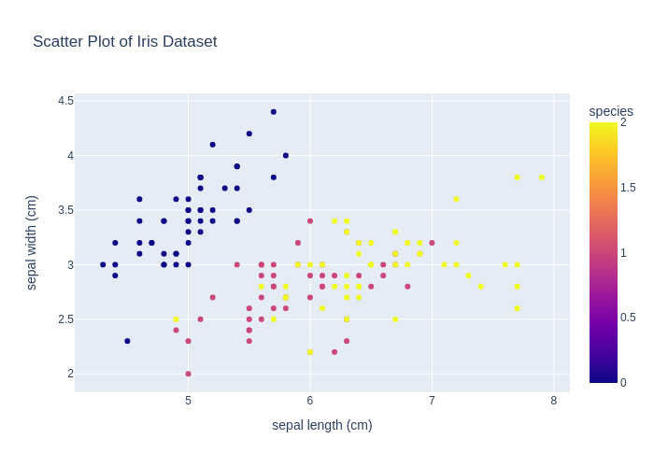
Scatter plot

Slide 16
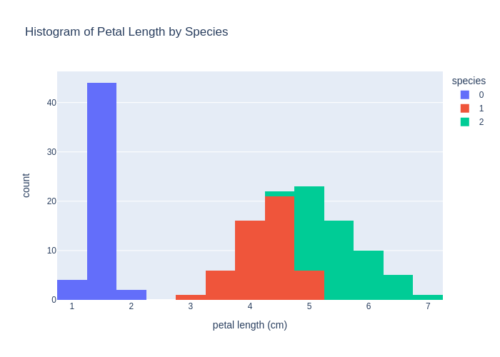
histogram

Slide 17

SUMMARY
Matplotlib offers extensive customization but demands more code, Seaborn simplifies statistical plots with built-in themes, and Plotly excels at creating dynamic and interactive visualizations

Slide 18
THANK YOU
Dhruv Joshi
dhruvjoshi2604@gmail.com
Dhruv1603/visualization (github.com)

